Slide 1
Polaris ILS Authority Control
5.0 SP3 Training

Slide 2
Polaris Authority Control
  Overview
  Authority records
  Options in Polaris
  Searching for authority records
  Library of Congress authority websites

Slide 3
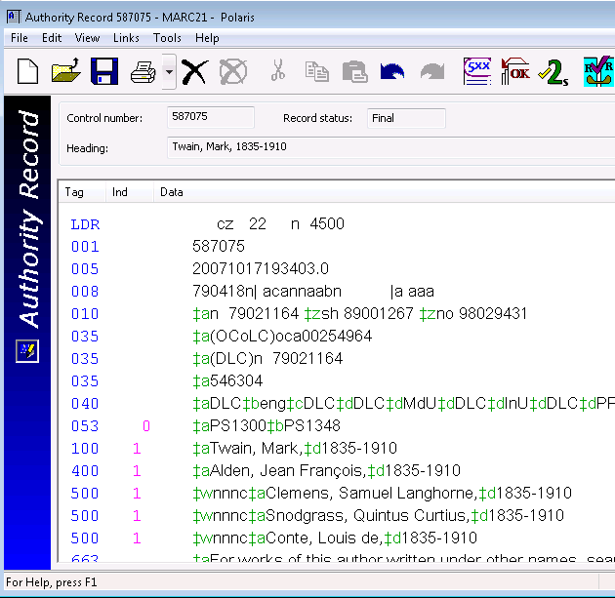
Overview
The purpose of authority control is to ensure that records can be retrieved consistently
Authority Records provide uniformity in the forms of names, some types of name/titles, series and subject headings

Slide 4
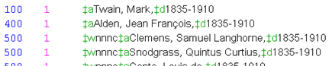
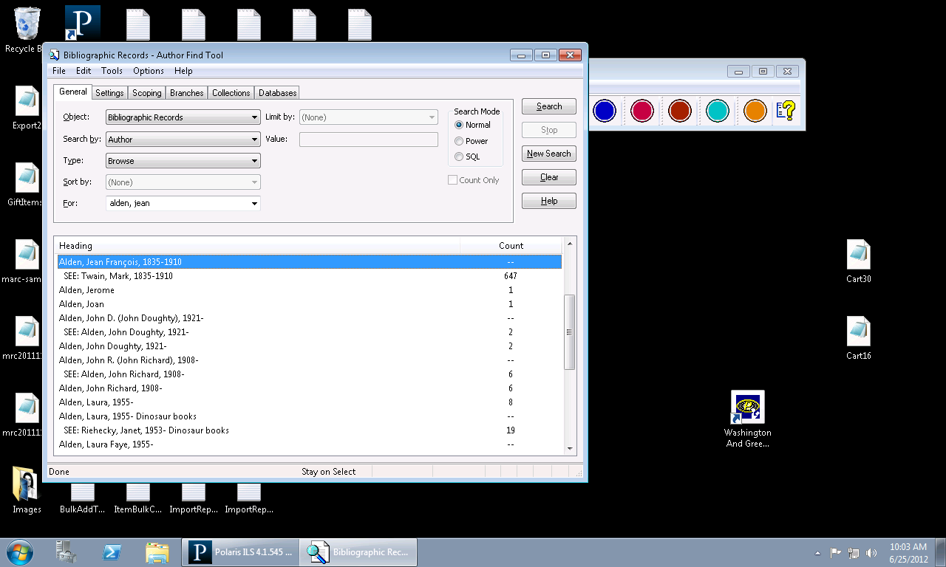
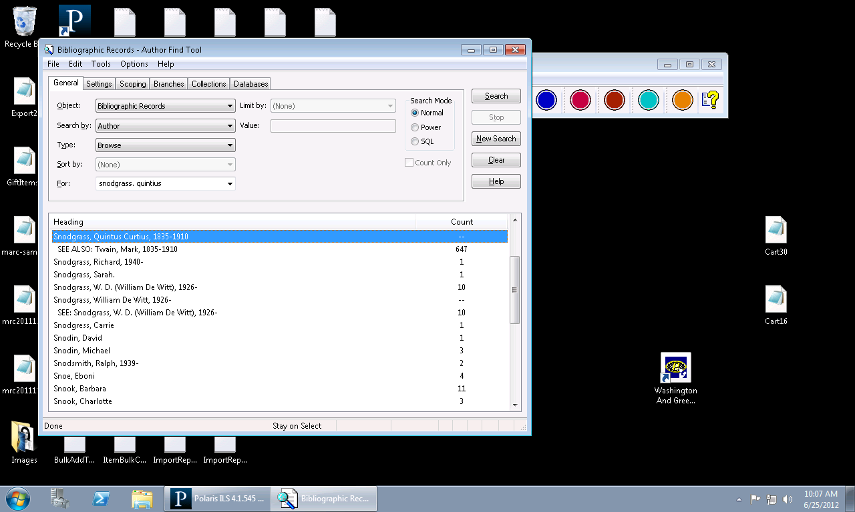
Overview
Authority control provides a system of cross references that
appear in bibliographic browse search results in the Polaris
Client and in the PAC
  See references point to the correct heading
  See Also references point to related headings

Slide 5
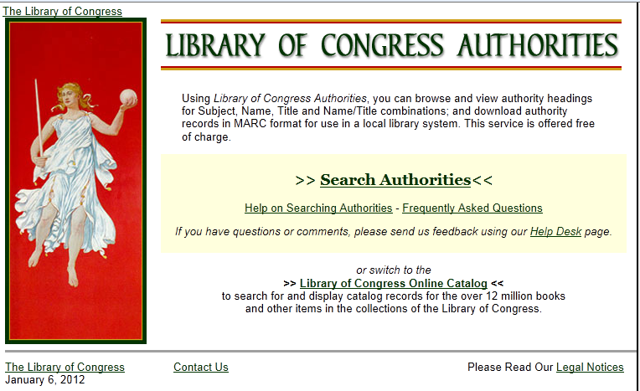
Overview
The Library of Congress Authorities web site provides free
access to LC Authority Records:
http://authorities.loc.gov

Slide 6
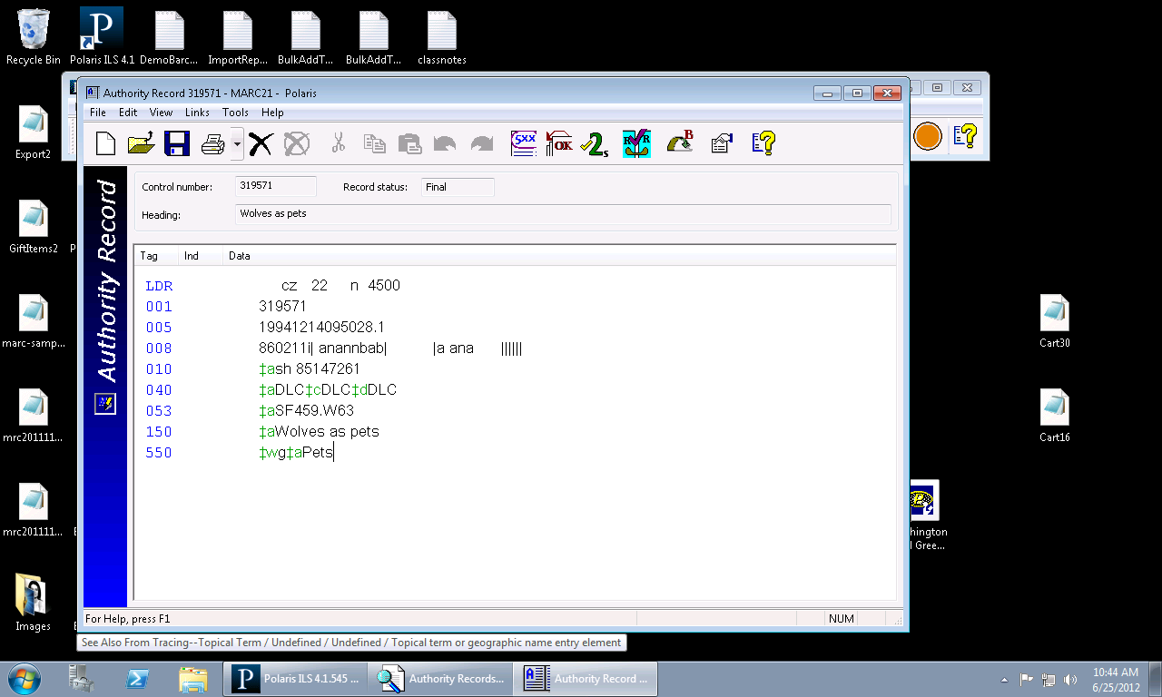
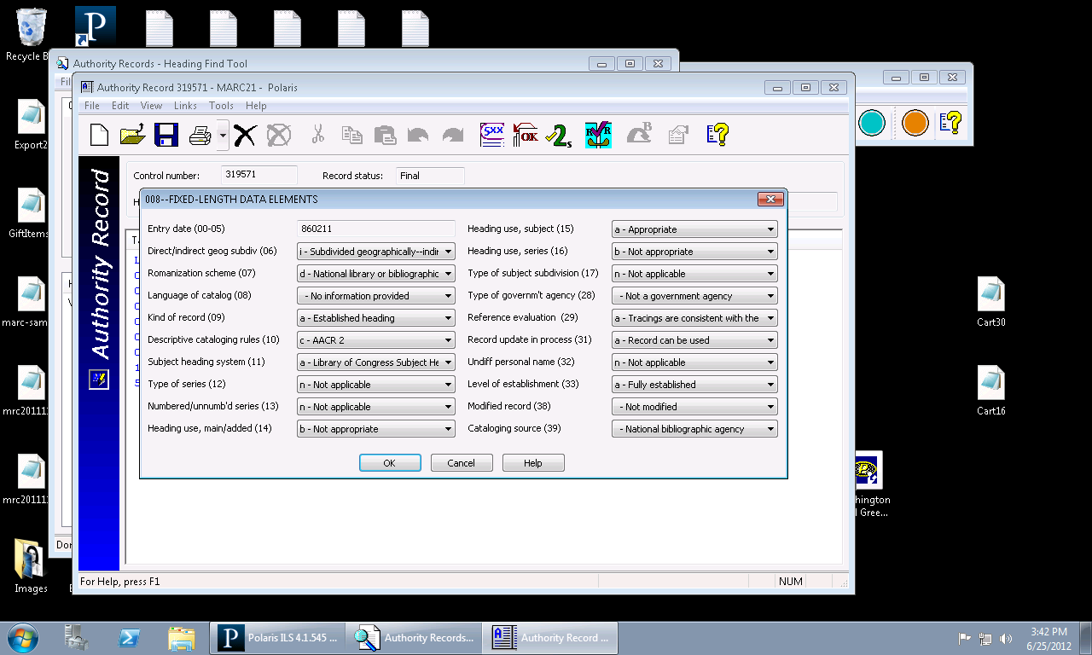
Authority Records
Authority records use MARC21 format
and are subject to MARC validation when
saved
Polaris does not use floating subdivisions
The entire string must have its own
authority record
The 008 field and correct indicators are extremely important for linking to occur
Position 09=Established
heading
Position 10=AACR2
Position 11 must define the
correct thesaurus used
Position 14, 15 and 16 must
be defined for appropriate usage

Slide 7
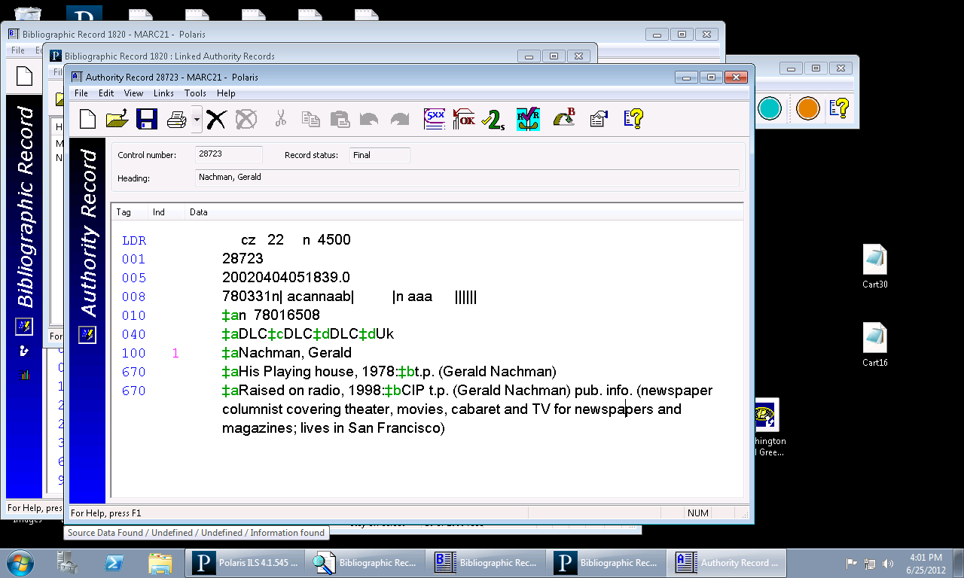
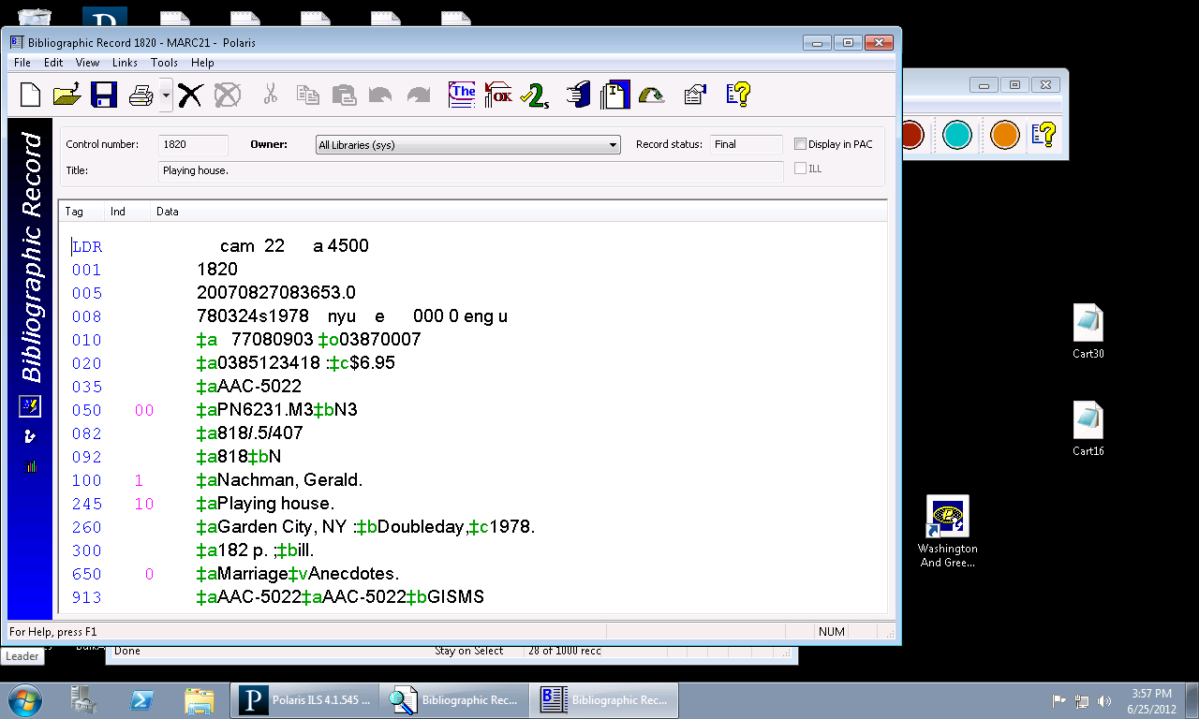
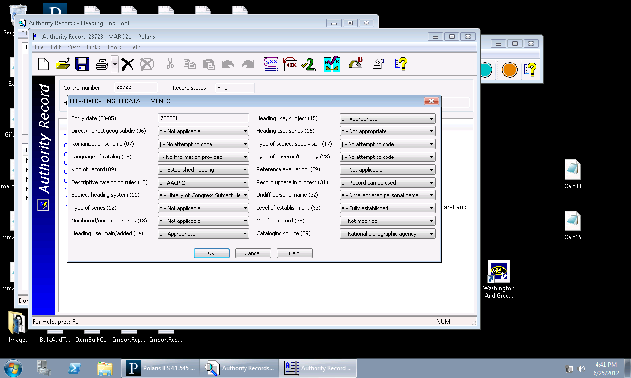
Authority Records
Indicator examples:
  If a 650 subject in a bibliographic record has a 0 in the second indicator position, the 008 position 11 of the authority record must read “Library of Congress Subject Headings” to match
  If the bibliographic records X00 has a 1 in the first indicator position, the authority record X00 first position indicator must also be a 1
Authority control can be done on some local headings
  690 and 691 subject headings. Second indicator must be 7 to trigger authority control.
  590 and 591 cross references in authority records

Slide 8
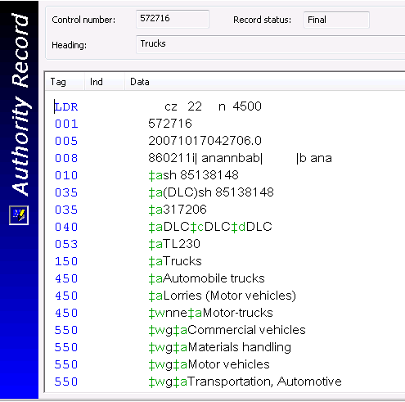
Authority Records
Cross reference system:
4XX (SEE):
  Is a variant form that is never used—it will always point to the authorized heading
  A See reference says ‘instead of this, use that’
  It never has its own authority record
5XX (SEE ALSO):
  Is a variant form that is also used
  A See Also reference says ‘this heading will also provide information’
  It should have its own authority record

Slide 9
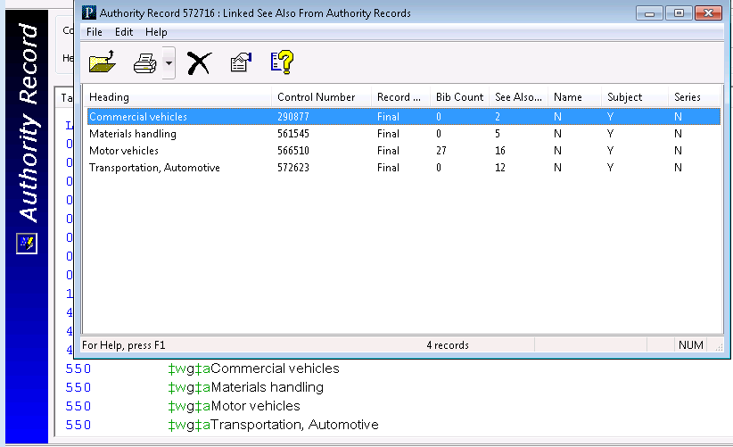
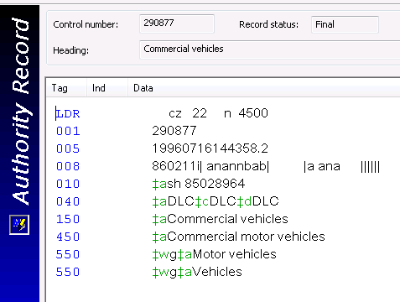
Authority Records
Linked See Also From Records

Slide 10
Authority Control Options in Polaris
Don’t use authority control—rely on keyword searching
Have bibliographic & authority data periodically processed by a 3rd party such as LTI or Backstage
  When the processed records are imported, links are automatically created
Manually retrieve and import the needed authority records from an external source
  When the new authority records are imported, links to existing bibliographic records are automatically created
Use authority templates to create individual authority records
Use the create function to make system-generated authority records
  This can be done when saving an individual bibliographic record
  This can be done during import
Use Remote Automatic Authority Control, a Z39.50 connection to an authority database, to retrieve needed records (subscription service)
  This can be done when saving an individual bibliographic record
  This can be done during import
Use Weekly Authority Updates to manage global headings changes (subscription service)
Use a combination of any of the above to maintain authority control

Slide 11
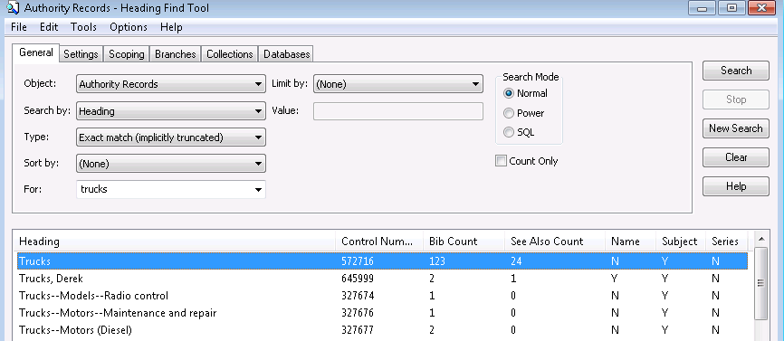
Searching for Authority Records
Searching by ‘Heading’ searches all authorized 1XX fields
Searching by ‘Tracing/Reference’ searches all 4XX and 5XX fields
The search results list shows:
  The number of bibliographic records that are linked to the heading
  Linked See Also authority records (the 1XX is a 5XX in another authority record)
  If the heading is Name, Subject and/or Series authorized

Slide 12
Library of Congress Authority Web Sites
Examples of authority records
http://www.loc.gov/marc/authority/examples.html
Concise MARC21 for authorities
http://www.loc.gov/marc/authority/
Structure of the LC Control Number
http://www.loc.gov/marc/lccn_structure.html
LC Authorities Database
http://authorities.loc.gov/
LC Z39.50 Targets: http://www.loc.gov/z3950/lcserver.html

Slide 13
Validating Headings
  Checking headings in bibliographic records
  Remote automatic authority control

Slide 14
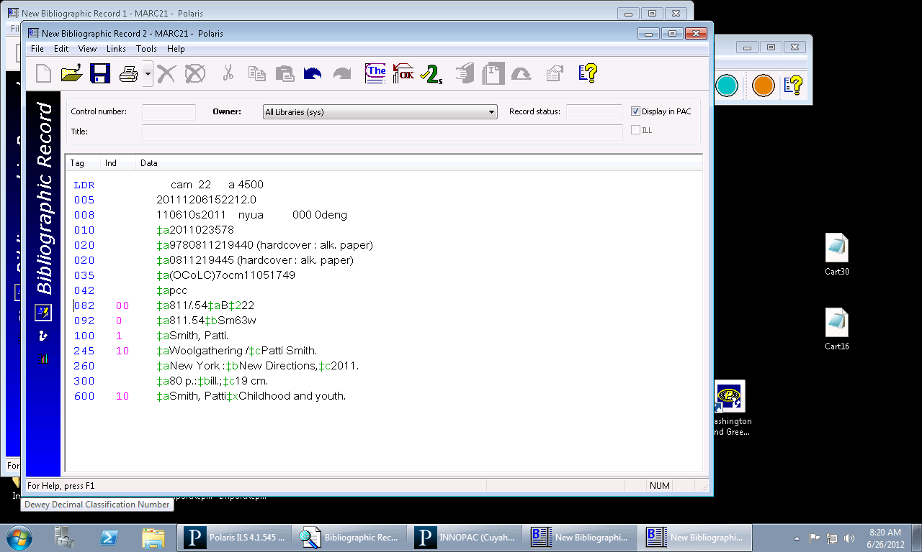
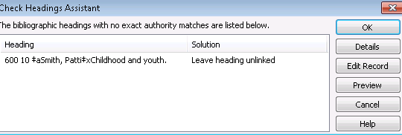
Checking Headings in Bibliographic Records
Hint:
The unauthorized headings can be dealt with one
at a time, or all at once by highlighting all
headings and clicking the Details button
Each time a bib record is saved as final, authority validation is the first check that is done by Polaris
Polaris will search for an existing authority record in the database and link to it if possible
The Check Headings Assistant dialog box appears if there are headings that remain unlinked
Depending on the library’s practice, these may or may not be authorized

Slide 15
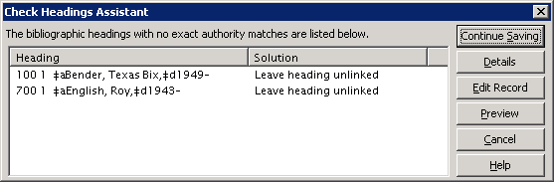
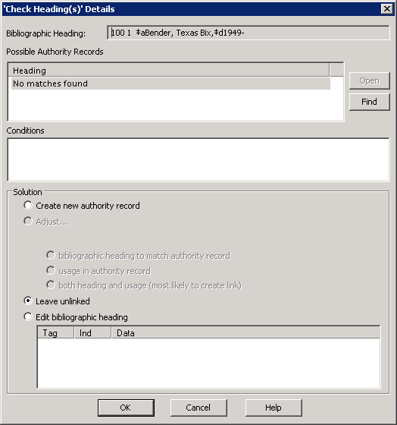
Checking Headings in Bibliographic Records
To work with a specific heading, highlight the heading and click the Details button
A search for a matching authority record is automatically done, however it is a very narrow search
Staff may have to use the Find button and perform a search for a known heading to link to

Slide 16
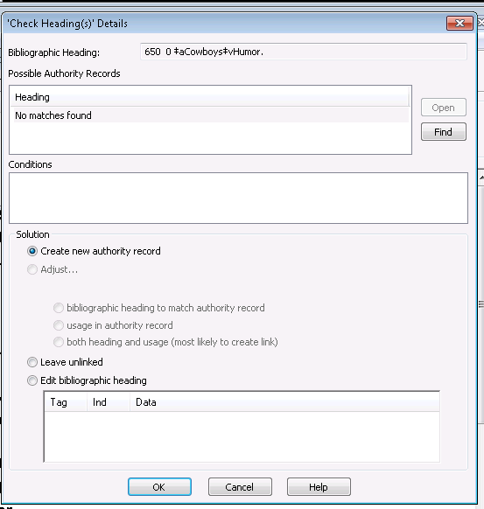
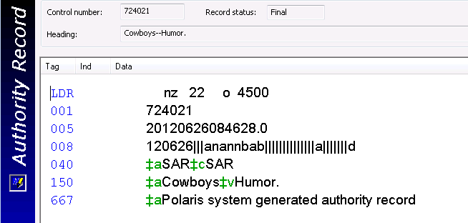
Checking Headings in Bibliographic Records
Depending on the possible authority records found, different options will become available in the Check Heading(s) Details dialog box
If there are no possible headings to link to, the only options will be to create a new system-generated authority record, leave the heading unlinked or edit the heading manually
Hint
System-generated authority records are very brief and may need editing

Slide 17
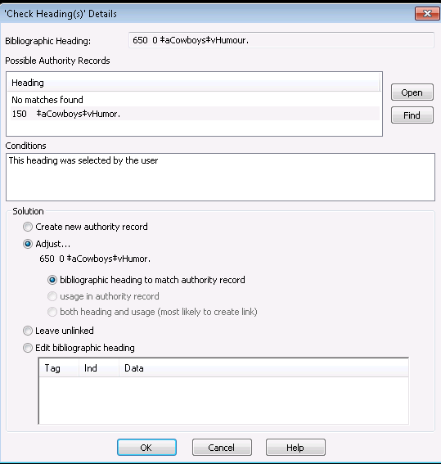
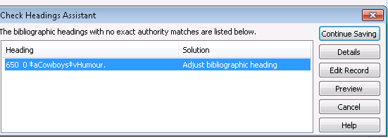
Checking Headings in Bibliographic Records
When a possible heading is found and highlighted, additional options become available.
The heading in the bib record can be adjusted:
  Bibliographic heading to match the authority
  record
  Usage in the authority record
  Both heading and usage
Other options:
  Creating a new authority record
  Leaving the heading unlinked
  Editing the heading manually
The Conditions box states why a link did not occur
Select the appropriate action and click OK
Result: The Check See Also From References
Assistant dialog displays the problem heading
and the solution

Slide 18
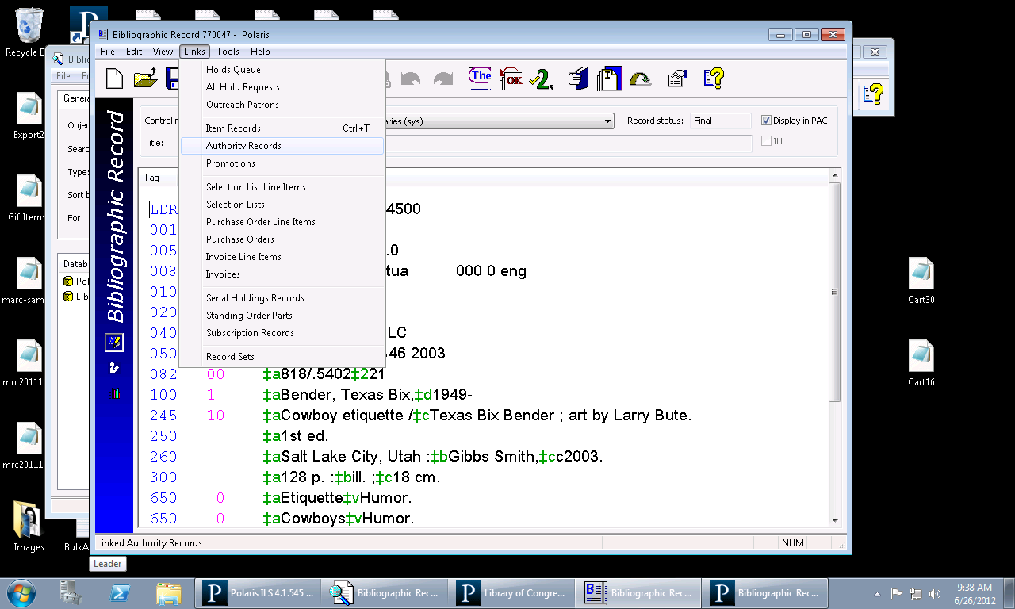
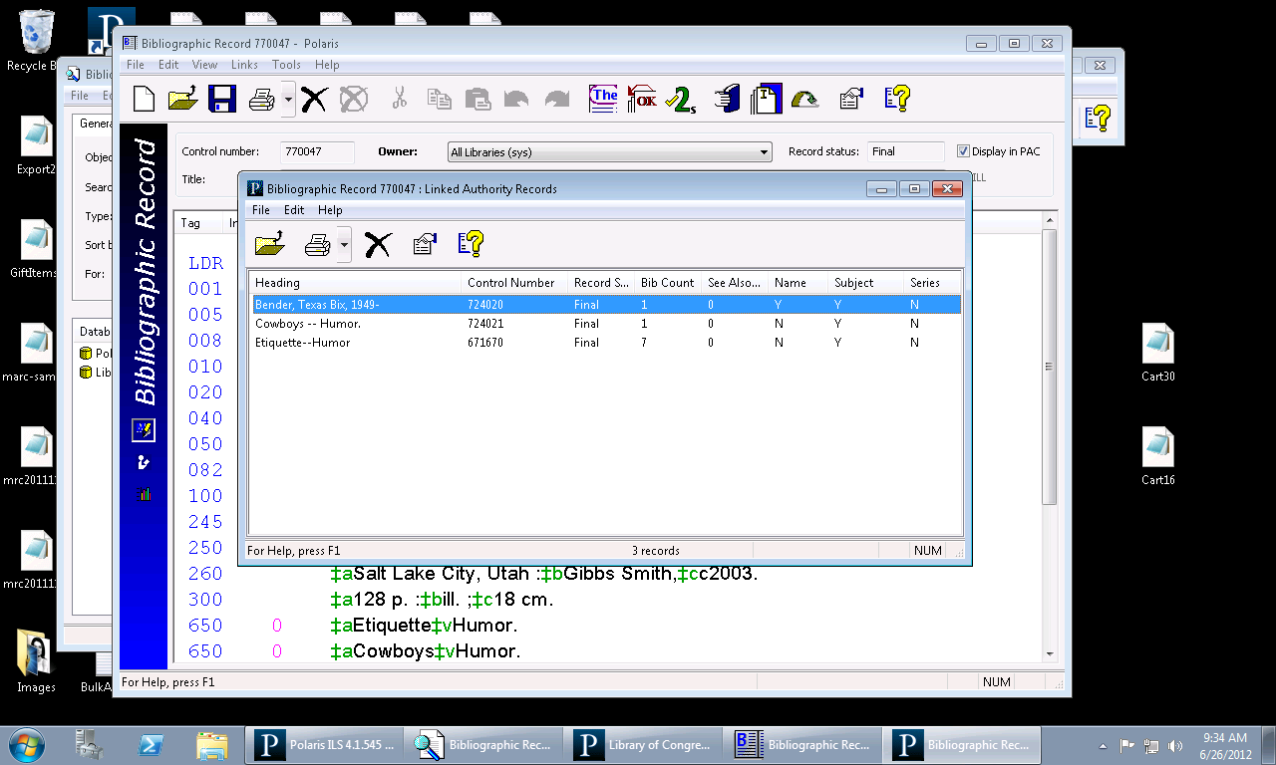
Checking Headings in Bibliographic Records
Once the bib record has been saved as final, staff can retrieve all linked authority records by going to Links/Authority records at the top of the bib record

Slide 19
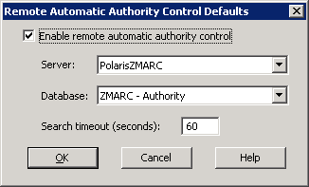
Remote Automatic Authority Control
Hint
To access the Remote Automatic Authority Control Defaults in System Administration, go to Profiles/Cataloging/Remote automatic
authority control
Remote Automatic Authority Control is the ability to search an
authority database for needed authority records via Z39.50
Polaris offers an authority database called ZMARC for Authorities on a subscription basis
ZMARC is a copy of the Library of Congress’ authority database
Remote Automatic Authority Control works two different ways:
  Each time a bibliographic record is individually saved
  During the import of bibliographic records

Slide 20
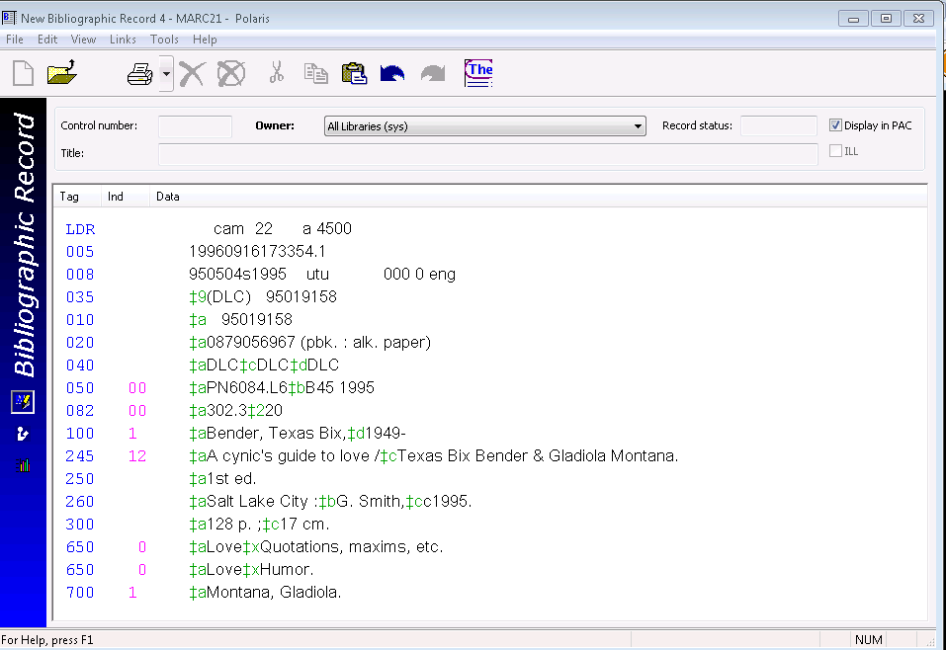
Remote Automatic Authority Control
Hint:
The remote database connection dialog flashes by very quickly.
Staff may not always see it
Remember that Polaris does not use
floating subdivisions—most often these are the headings that are left over and need to be authorized
Any time a bib record is individually saved and a authority record is needed, the remote automatic authority control launches to the linked database to retrieve a valid authority record
As the authority records are imported, their headings are linked to the bibliographic record headings
Any remaining unlinked headings will still appear in the Check Headings Assistant dialog box

Slide 21
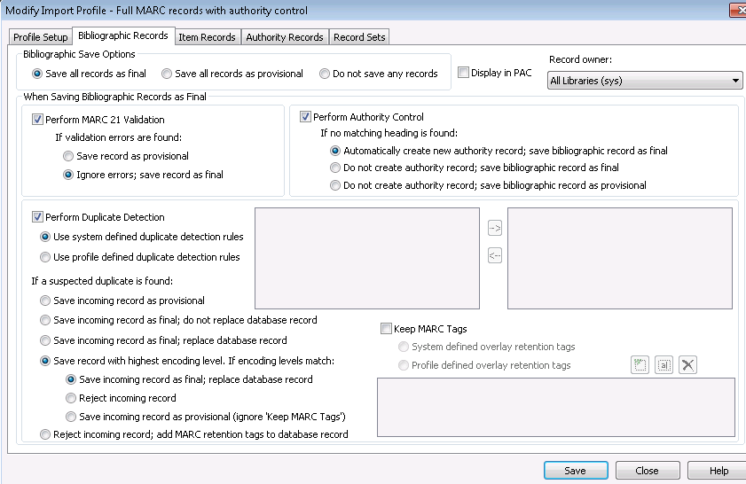
Remote Automatic Authority Control
If the library uses Remote Automatic Authority Control, the authority
database will automatically be searched and needed authorities brought
in during import
This is an example of an import profile where
authority control has been turned on:
Selecting ‘Perform Authority Control’ automatically activates the launch to the authority database
Links a heading if an authority record exists
Launches to the authority database if one is needed
Any remaining unlinked authorities are listed on the import report as system generated authorities are not created

Slide 22
Creating Authority Records
  Using templates
  Linking to bibliographic records
  MARC21 validation
  Authority record deduplication and authority overlay retention

Slide 23
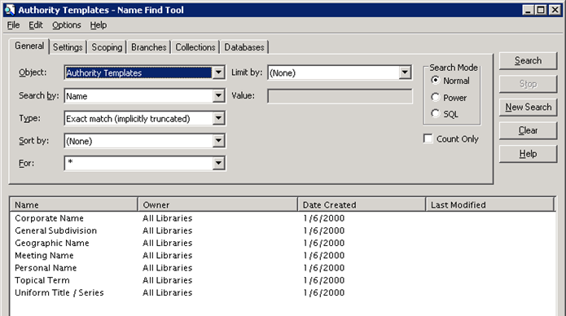
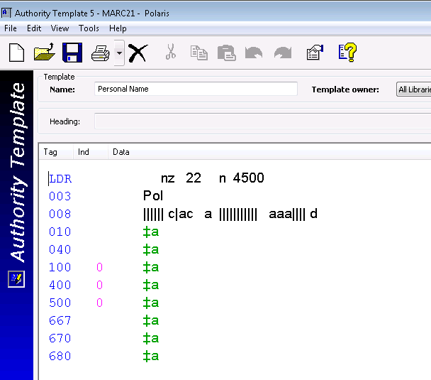
Using Templates
Hint
To retrieve existing authority templates, from the Polaris toolbar, go to Cataloging/
Templates/Authority
Like bib records, authority records may be be created from templates
Polaris comes with a few predefined authority templates
Authority record templates can be created by:
  Clicking the New icon on the Polaris toolbar and select Authority Template
  Copy an existing authority template
  Save an existing authority record as a template

Slide 24
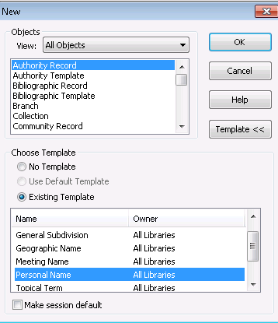
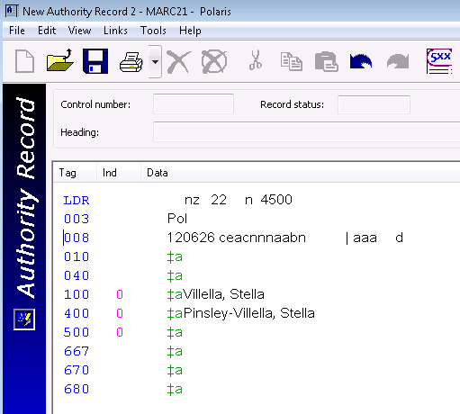
Using Templates
Hint
To create a new authority record using a template, from the Polaris toolbar, click the New icon and select Authority Record
Click the Existing Template radio button and select a template
Click OK
Add all needed information using the same editing techniques that are used with bib records
Remember, fixed fields and indicators are very important
Diacritics and macros may also be used with authority records

Slide 25
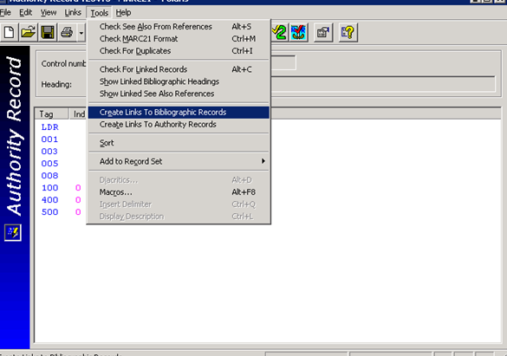
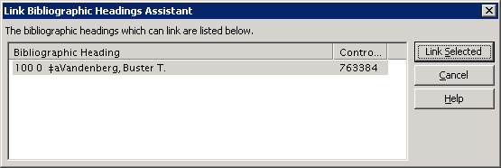
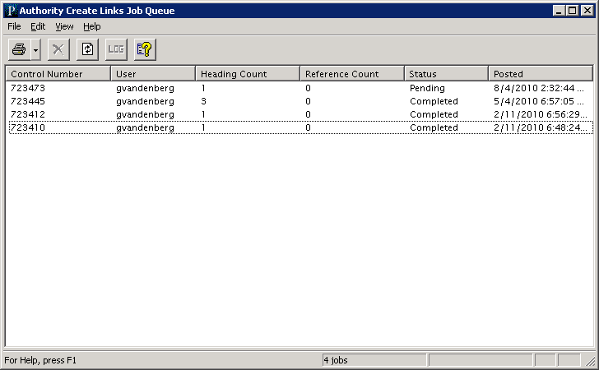
Linking to Bibliographic Records
Hint
To link the newly created authority record to
bib records, from the authority record, select
Tools/Create Links To Bibliographic Records
When creating links to bibliographic records, the Link Bibliographic Headings Assistant dialog box will list all bib records with matching headings
After the Link Selected button has been clicked, a job is posted to Utilities/Cataloging Processing/Authority Create Links Queue
When this job is completed, all appropriate bibs will be linked to the authority record

Slide 26
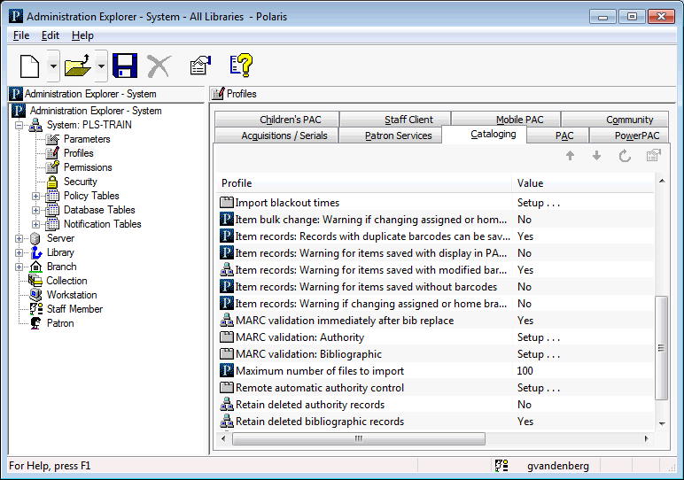
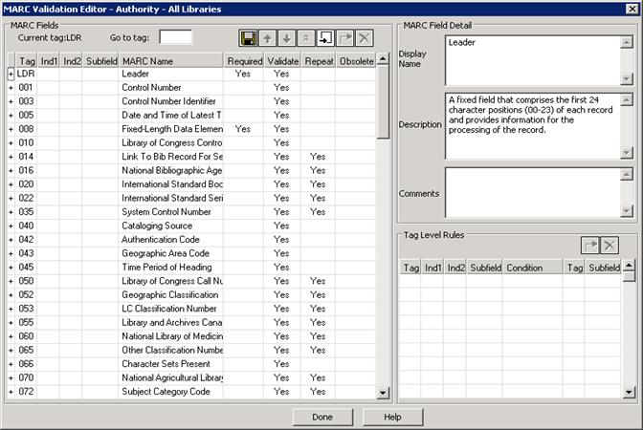
MARC21 Validation
Hint
To access the authority record validation table, go to Profiles/Cataloging/MARC validation: Authority
Just like bib records, authority records are subject to MARC validation.
Validation takes place when a record is saved or the Check MARC21 Format icon at the top of the authority record is clicked
Local fields may be added to this table so that they can be validated

Slide 27
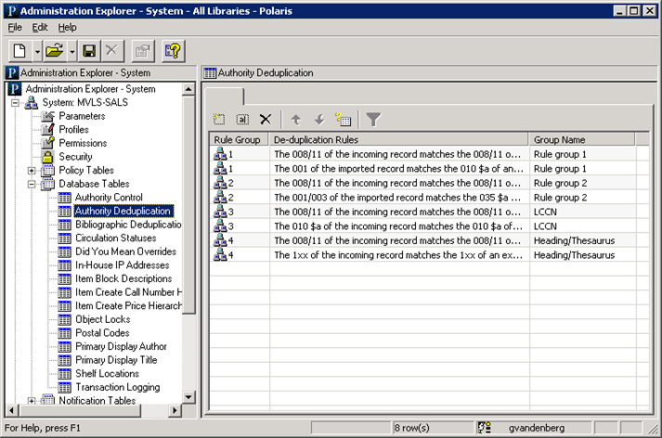
Authority Record Deduplication
and Overlay Retention
Hint
To access the authority deduplication rules, go to Database Tables/Authority Deduplication
Protect desired fields when replacing/merging
authority records with the Authority Overlay
Retention Policy Table
Duplication detection is also performed when an authority record is saved or when the Check for Duplicates icon is clicked at the top of the record
These rules work the same way the Bibliographic Deduplication rules work
If local fields are defined in the authority MARC validation tables, consider adding those fields to the Authority Overlay Retention Policy Table

Slide 28
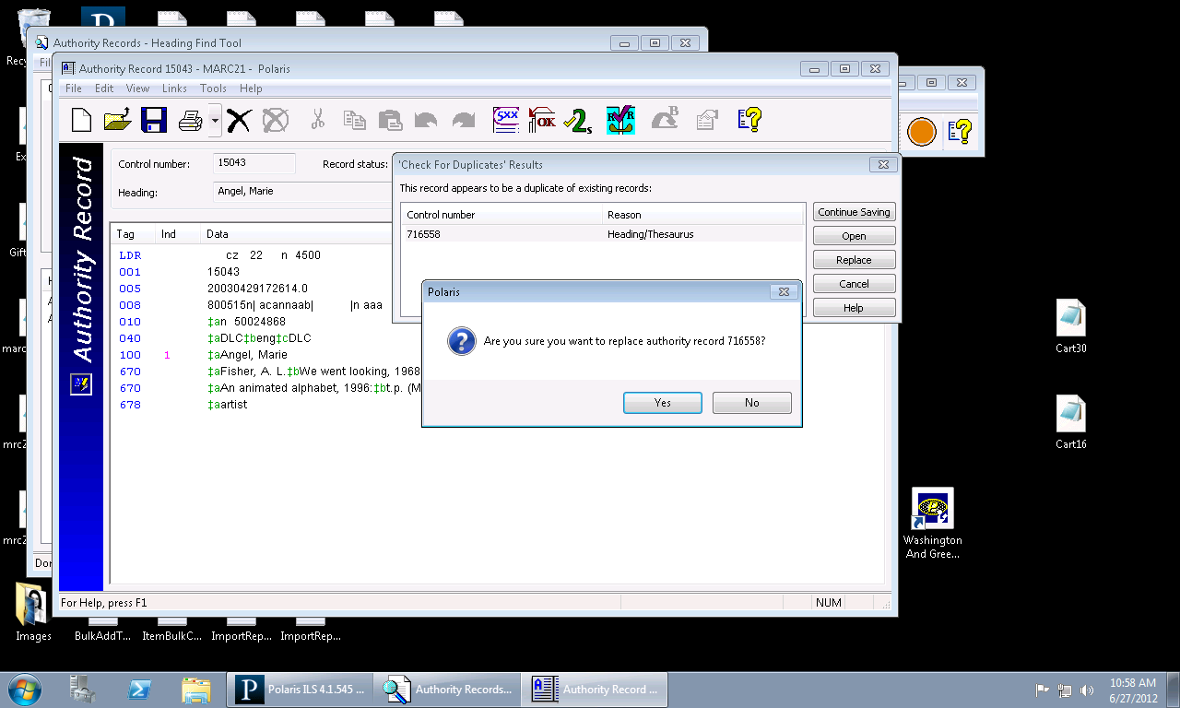
Authority Record Deduplication
and Overlay Retention
Notes on merging authority records:
Unlike bibliographic records:
Multiple authority duplicates may not be selected to be replaced at the same time
You may not check for duplicates to begin the merge process
You may only merge headings as the result of saving a new or modified authority record
At the point of saving a new or edited authority record, if a duplicate authority record is detected, the Check for Duplicate Records dialog box will appear
Click the Open button to review the possible duplicate
Click the Replace button to merge/replace the record, and click “Yes” in the “Are you sure” prompt.
All linked bibliographic records are attached to the new authority record

Slide 29
Working with Existing Authority Records
  Checking See Also headings in authority records
  Linking to other authority records
  Deleting authority records

Slide 30
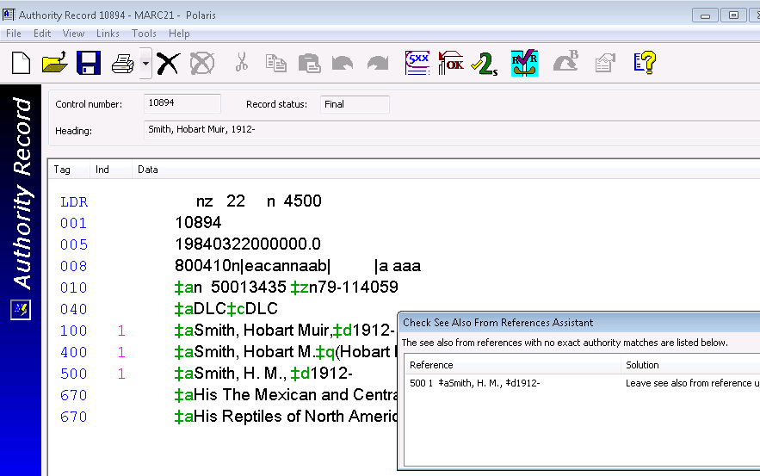
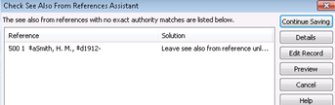
Checking See Also Headings in Authority Records
Hint
SEE ALSO—a 1XX is in a 5XX field in
another authority record
SEE ALSO FROM—a 5XX is in a 1XX field in another authority record
To verify current links, from the “Links” menu, select Links/Authority Records/See Also References or See Also From References
Authority checking is done on authority records when the record is saved as final
If there are problems, the “Check See Also from References Assistant” dialog presents options for saving the record

Slide 31
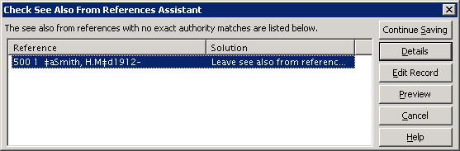
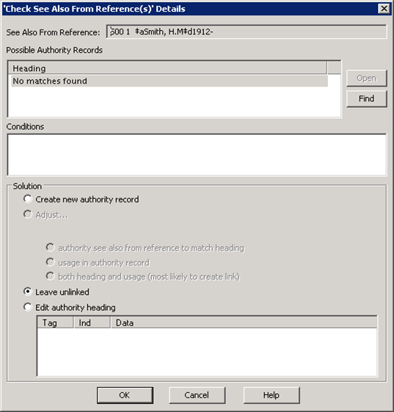
Checking See Also References in Authority Records
To work with a specific heading, highlight the heading and click the Details button
Remember: the system’s search for possible matching authority records is a very narrow search
Use the Find button to manually perform a search for a known heading to select and create a link to

Slide 32
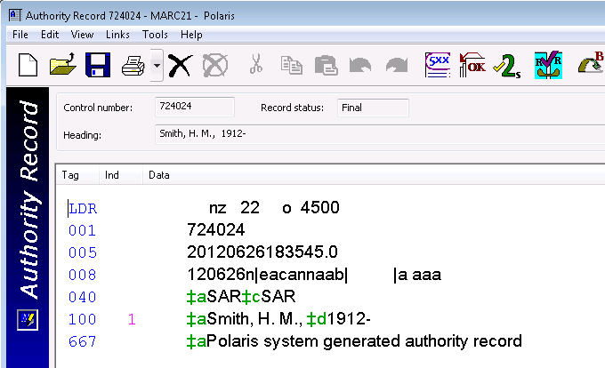
Checking See Also References in Authority Records
Depending on the possible authority
records found, different options will
become available in the Check See Also
From Reference(s) Details dialog
If there are no possible headings to link to,
there are three possible solutions:
  Create a new system-generated authority record
  Leave the heading unlinked
  Edit the heading manually
Hint
System-generated authority records are very brief and may need editing

Slide 33
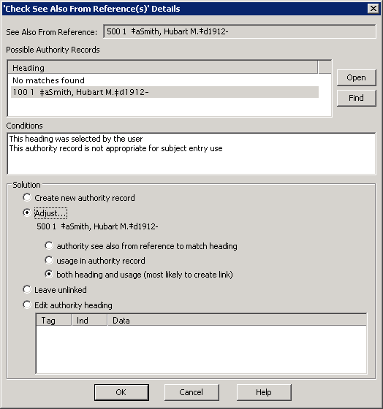
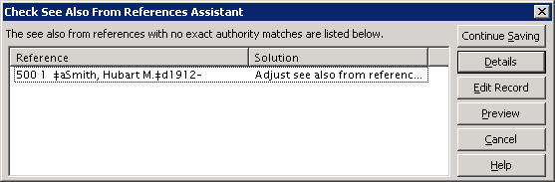
Checking See Also References in Authority Records
Selecting a possible heading makes additional options available:
Options for adjusting the heading:
  Authority see also from reference to matching heading
  Usage in authority record
  Both heading and usage
Creating a new authority record, leaving the heading unlinked and editing the heading manually also remain options
The Conditions box supplies the reason why a link did not occur
Select the appropriate action and click OK
Result: The Check See Also From References Assistant dialog displays the problem heading and the solution

Slide 34
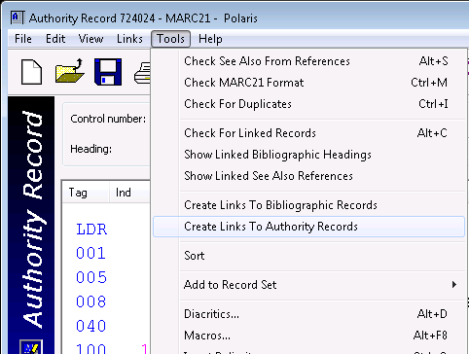
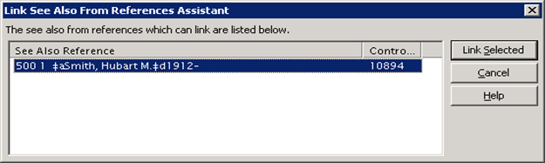
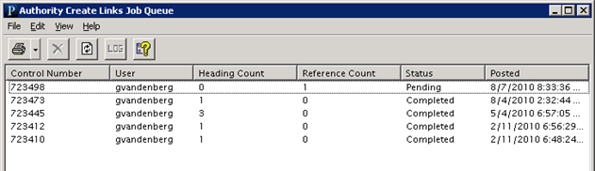
Linking to Other Authority Records
To create links to authority records:
  In the new record, go to Tools/Create Links to Authority Records
  Select the authority records to be linked
  Click the “Link Selected” button.
A new authority record can be made from a template and may need to be linked with other authority records
Go to Utilities/Cataloging Processing/Authority Create Links Queue to monitor the progress of the job

Slide 35
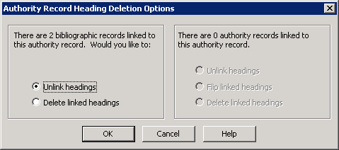
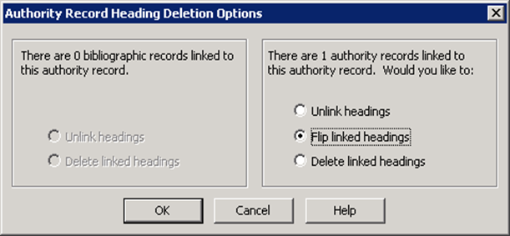
Deleting Authority Records
When deleting authority records and there are attached bib and/or authority records, the Authority Record Heading Deletion Options dialog box will appear
Select the option per the library’s standard and click OK

Slide 36
Global headings changes
  Editing authority records and updating linked records
  Viewing the Authority Update Links Queue
  Weekly Authority Updates

Slide 37


Editing authority records and updating linked records
Make the desired edits in the authority record and save it
Go to Tools/Check For Linked Records, or press Alt+C
Click “Continue Saving” to post the job to the queue

Slide 38


Viewing the Authority Update Links Queue
Go to Utilities/Cataloging Processing/Authority Update Links Queue
Click the refresh icon to view the job’s current status
Double-click the selected job, or click the “Report” icon to review the Log when the job is complete

Slide 39
Weekly Authority Updates
Weekly Authority Updates is a subscription service through Polaris
Each week a scheduled job at Polaris reviews the library’s authority records to see if there are headings that qualify for global updating
If updating is needed, a file of new authority records is delivered to the library’s server
A defined staff member will receive an email letting them know authority records are available and where they are on the server
This file must be manually retrieved and imported into the database to complete the update of authority records
  The authority record will be updated
  All linked bibs will be updated
An example import profile, Authority Update Import, can be copied and edited per the library’s needs

Slide 40
Importing and Authority File Maintenance
  Importing:
    Importing authority records
    Creating authority records through a bibliographic import
  Tools for Authority File Maintenance:
    Polaris Toolbar Reports
    Create an unlinked authority record set

Slide 41

Importing Authority Records
Hint
To create a new import profile, go to Utilities/Importing/
Profile Manager
To apply the import profile, go to
Utilities/Importing/
Express or Full Import.
If the library’s practice is to export authorities from a database and import them all at once, an import profile can be set up to process the authority records
An import profile can be set up to create authority records for 5XX fields of the incoming authority records if needed
The new authority records are automatically linked to bibs upon import

Slide 42

Creating Authority Records through a Bibliographic Import
An import profile can be set up to automatically create new authority records if no matching heading is found

Slide 43

Polaris Toolbar Reports
To view all available authority toolbar reports:
  Go to Utilities/Reports and Notices
  Expand the Cataloging folder
  Select the Authority subfolder

Slide 44
Polaris Toolbar Reports
Authority Records where 4XX matches 1XX
  Identifies authority records where a See reference (4XX field) in one record matches a heading (1XX field) in another record in the database
  It also lists situations where the same authority record contains a 1XX and 4XX that match because of normalization (and/&)
Authority Records With No Linked Bibs
  Authority records with no linked bibs, but there may be other linked authorities
Problem Authority Records
  Identifies possible duplicate authority headings where the normalized text is the heading of more than one authority record
Unlinked Authority Records
  Identifies all headings which are not used by any bibliographic record or as a cross-reference for other headings—these records may be deleted

Slide 45


Creating an Unlinked Authority Record Set
Hint
To create an unlinked authority record set:
Go to Utilities/Cataloging Process/Create Unlinked Authority Record Set
Orphaned authority records are identified by the icon at the beginning of the heading
No bibs or other authority records are linked to these records

