Slide 1
Introduction to Polaris ILS
5.0 SP3 Training

Slide 2
Polaris Client Basics
Logging On and Off of the Client
Shortcut Bar
Staff Client Visual Alert Configuration
Modifying Text Size and Resolution

Slide 3

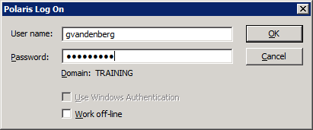
Logging On and Off of the client
Click on the Polaris icon to bring up the Polaris Log on screen
Enter your username and password, verify the domain, and click OK
Even though your user name is not case sensitive, your password is

Slide 4
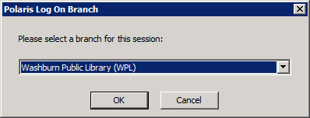
Logging On and Off of the client
You may be logged directly into the branch you always work at and never see this window
However, if your library has multiple branches you may be asked to select which branch you would like to log into

Slide 5
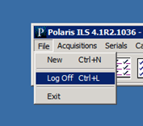
Logging On and Off of the client
You can log off of Polaris by either going to File/Log off, by using the keystroke Ctrl+L or by clicking the ‘X’ in the upper right corner of the Polaris shortcut bar
If you are using a Terminal Server environment, make sure you log out correctly from the Start menu

Slide 6
Shortcut bar
Drop-down menus
Icons
The shortcut bar is your Polaris navigational tool
Once you have logged in, your user name and branch abbreviation will display on the top of the shortcut bar
The toolbar offers access to subsystems through drop-down menus or by clicking on icons

Slide 7
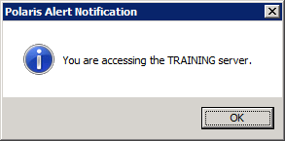
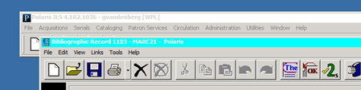
Staff client visual alert configuration
Inactive window
Active window
There are two ways to signal staff when they are logging into the training server:
  Logon alert message
  Custom title bar color
These alerts may be used individually or in conjunction with one another
They may be set on each server so you know immediately which server you are logging onto—training or production

Slide 8
Modify text size and resolution
Text:
  Using Control Panel/Display on your PC, you may set your computer’s display from Small to Medium or Large and the Polaris interface will reflect these changes without reducing what is visible on the screen
  Workstations must be running Windows Vista, Windows 7 or Windows 8.
  IMPORTANT—This option is not supported in Terminal Services
Resolution:
  Polaris will be optimized for monitors set at 1024 x 768 resolution
  Customers using large monitors will be able to set them at this resolution

Slide 9
Navigation in Polaris
Drop-down Menus
Icons
Shortcut Keys
Linking in Polaris
Permission Blocks
Where to find help

Slide 10
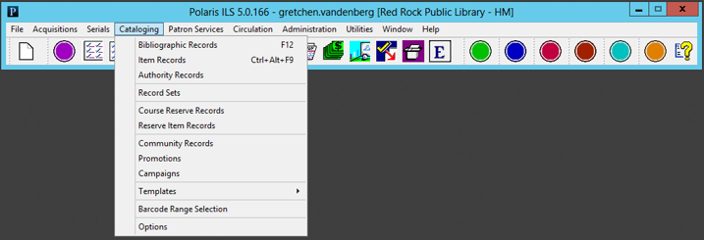
Dropdown menus
Clicking on each title in the menu bar presents a drop-down menu to access functions in each subsystem

Slide 11

Icons
Tooltip
Icon for Patron Services
Another way to access the Polaris subsystems is to click on the corresponding icon on the tool bar
Hovering over each icon brings up a tooltip hint to show you what you may access when clicking on the icon
Clicking on a round icon “slides open” the subsystem’s menu to present the related icons
Each subsystem is color coded—Cataloging is blue, circulation is red, etc.

Slide 12
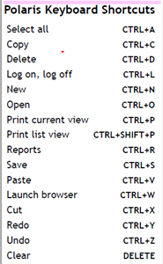
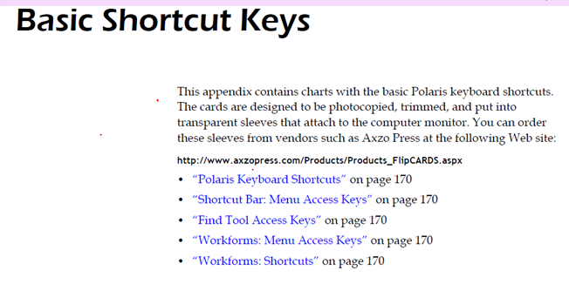
Shortcut keys
For users familiar with Windows Shortcuts, many are built into Polaris
Numerous CTRL and ALT combinations will bring up menus and workforms in Polaris
Keyboard shortcut cheat sheets can be found at the end of each user guide for a particular subsystem

Slide 13
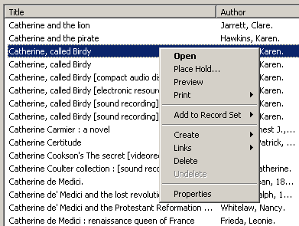
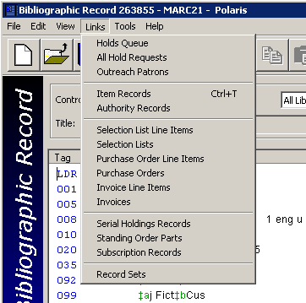
Linking in Polaris
One of the fastest ways to navigate in Polaris is by linking from one record to another
  From a result set in the Find Tool, right click and choose Links
  From a workform, go to Links in the menu bar
You can link to other workforms or perform specific functions without additional keystrokes

Slide 14
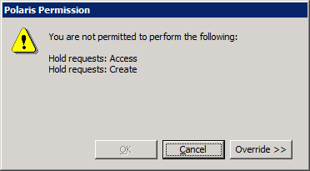
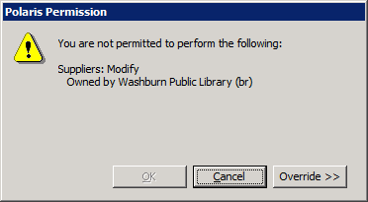
Permission blocks
You may encounter a message that says that you do not have permission to complete a certain task
Click Override and ask someone with the permission to override blocks in that subsystem to enter their user name and password for a one time override
If this is a permission that you frequently need, write down the exact wording of the permission from the pop-up message to give to your System Administrator

Slide 15

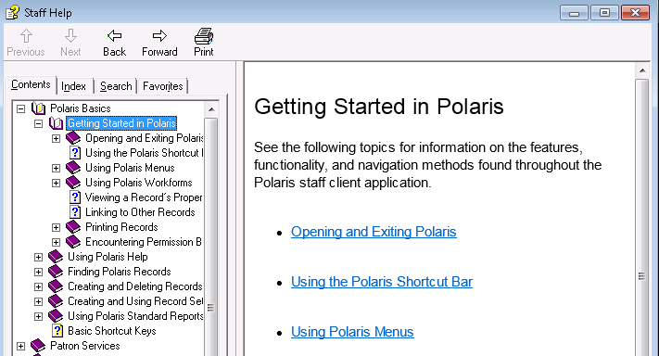


Where to find help
Documentation may be seen by going to Help/Polaris Topics on the Shortcut bar
Content-specific help can be accessed by pressing the F1 key or clicking on the help icon in the toolbar on any workform
Topics may be saved on the Favorites tab and stay with your user ID

Slide 16
Find Tool
Types of Searches
Setting User Defaults
Wildcard Characters
Find Tool Tabs
Additional Find Tool Searches
Search Results

Slide 17
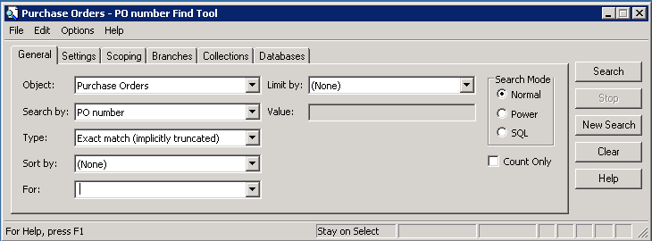
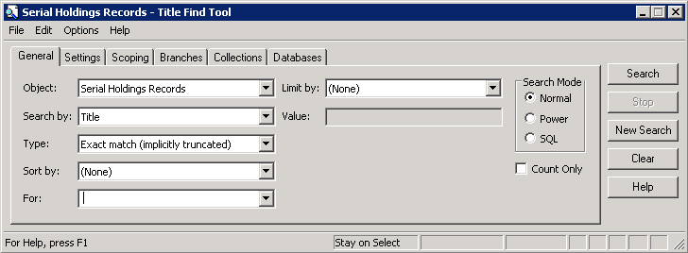
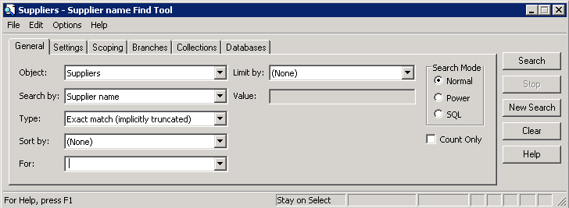
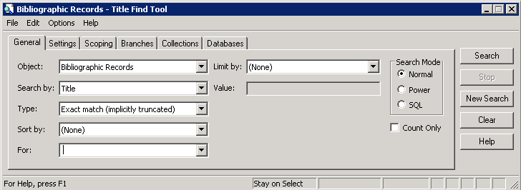
Find Tool
The Find Tool has the same format in all subsystems, but with different options/indexes in the drop-down menus
  Object—what you are looking for
  Search by—what index you would like to use
  Type—What type of search you would like to perform
  For—type in your search terms
The Find Tool allows users to do everything from basic to advanced searching

Slide 18
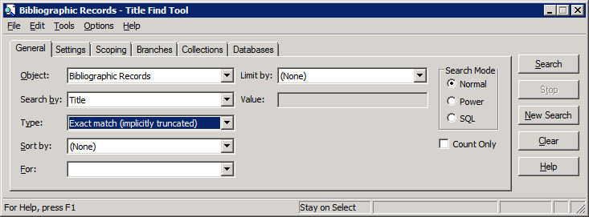
Types of searches
Exact match (implicitly truncated)
  Displays all records beginning with the characters entered in the For box
  No asterisk is needed after the term(s) as truncation is implied

Slide 19
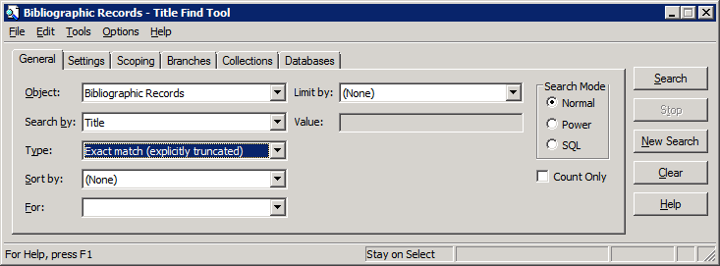
Types of searches
Exact match (explicitly truncated)
  Displays only the records that exactly match the characters in the For box
  If you enter an asterisk after the search term(s) the results are the same as they would be on an implicitly truncated search
  Helpful for one word title searches

Slide 20
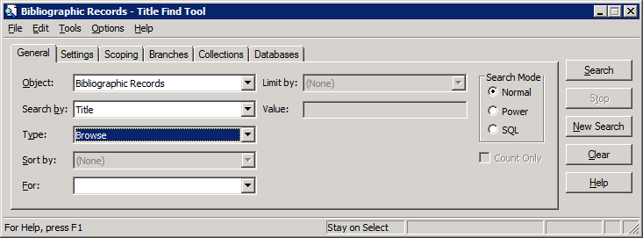
Types of searches
Browse
  Displays the specified index headings beginning with entries that start with text in the For box
  Unicode compliant—diacritics or special characters are accepted if they match the heading
  Name indexes are searched in the last name, first name format—no comma is necessary

Slide 21
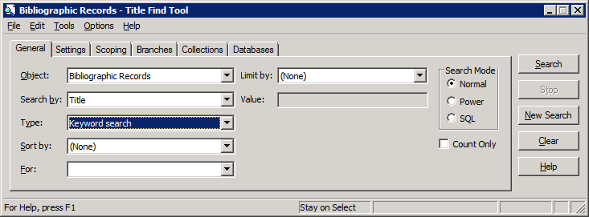
Types of searches
Keyword search
  Finds records that include the exact search term or terms in any order
  There is an implied AND between each word entered as a search term
  Offers auto-suggest feature if enabled

Slide 22

Types of Searches
Phrase search
  A specialized keyword search that searches multiple words in the exact order in which they were entered
  Offers auto-suggest feature if enabled

Slide 23
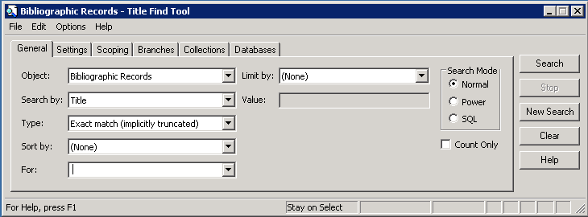
Setting user defaults
Users may define custom search defaults on the General tab of each Find Tool
Defaults include Search by, Type, Sort by and Limit by
Once selections are made for default searches, go to Options/Save as User Default to have those settings take effect
Settings are linked to a username

Slide 24
Wildcard characters
An asterisk * and a question mark ? Are valid wildcard characters
They may be used with multiple search types, for example:
  Keyword
    note = note
    note* = note, notes, notebook
    *note = footnote
    *note* = footnotes
  Exact match—implicitly truncated
    metal = metal, metals, metalsmith
    *metal - fullmetal

Slide 25
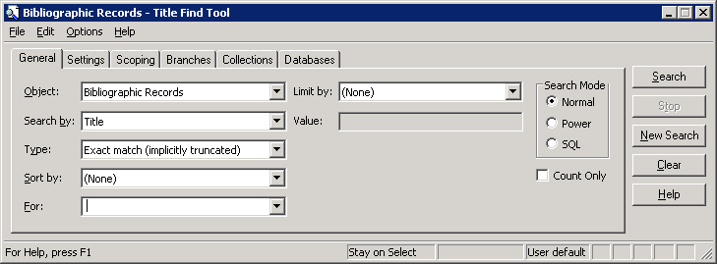
Find tool tabs--General
Object—default object is selected but this may be changed to any object in the dropdown list
Search By—access point or index
Type—type of search to perform
Sort by—order of the results
For—where the user enters the search string
Limit by—add a narrowing criterion if available-some limits allow multiple values to be selected

Slide 26
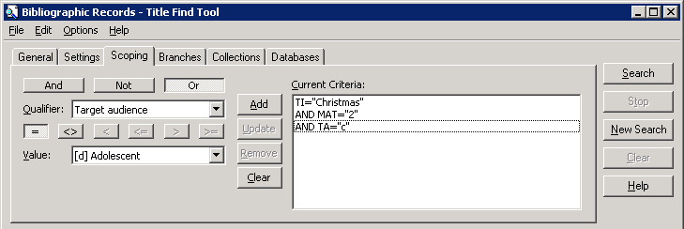
Find tool tabs--scoping
Begin your search on the general tab and then narrow the search further by using the scoping tab
Select the operators, qualifiers and value
Add the criteria to the search string by clicking the Add button

Slide 27
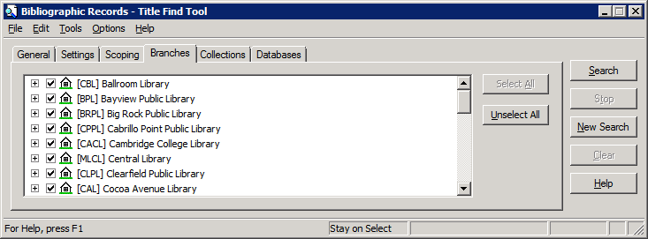
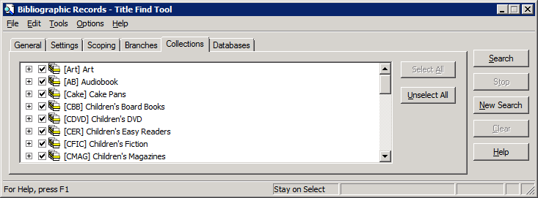
Find tool tabs—branches and collections
Some searches can be narrowed by opening the branches and/or collections tabs and making additional selections
Tip—use the Unselect All button to clear all Branches or Collections, then click the desired boxes

Slide 28

Additional Find Tool Searches
Power—gives staff the ability to use CCL (Common Command Language) to create a search
SQL—if permissions are given, allows staff to create, save and run SQL queries within the Find Tool
Count Only—allows staff to get a quick count of records without displaying the results list—helpful for reporting purposes

Slide 29
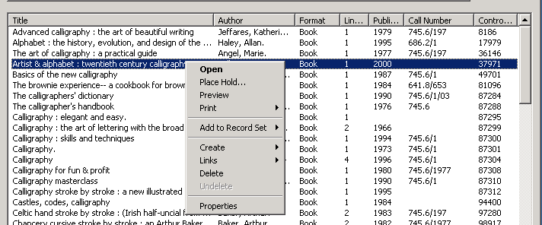
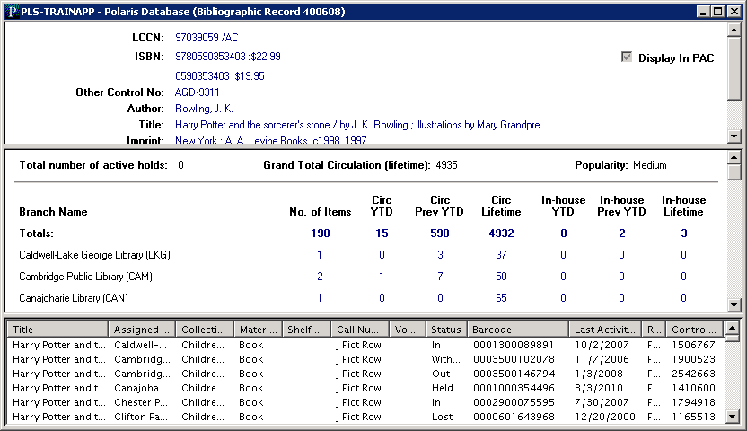
Search results
Sort—by clicking the column headers, lists can be sorted in ascending or descending order
Right-click—allows staff to easily move into other functionality or link to related workforms
Preview—allows staff to see quick information about a title and all connected items—staff can easily move through a list of titles by using the arrow up and down keys

Slide 30
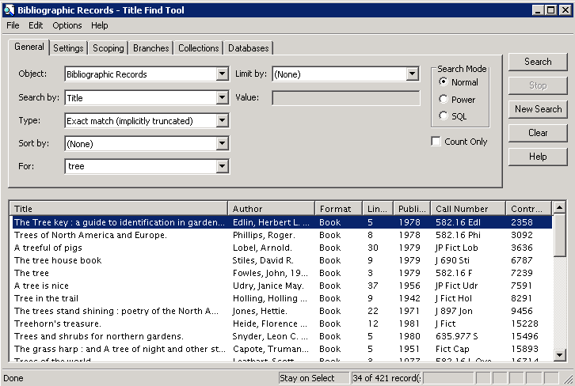


Search results
Karate Chop
If the result set is large, only a subset of the results is initially brought back
CTRL+Shift+A will retrieve all the records

Slide 31
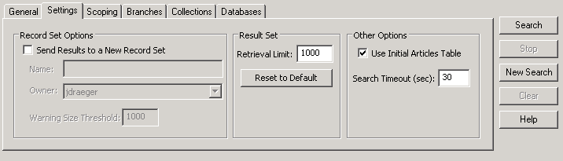
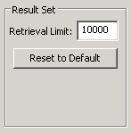


Search results
There is a default limit set in System Administration (typically 1000) for the maximum number of records retrieved in a search
Go to the Settings tab, edit the value in Retrieval Limit and click Search
Karate Chop (Ctrl + Shift + A) to see all the results

Slide 32
Workforms
Workform Layout
Property Sheets
Notes:
Sierra has the functionality necessary to support the most complex of library workflows.
The Sierra Services Platform is designed from the ground up to seamlessly integrate shared resources, to be extensible through open data structures and API’s and deliver information anywhere by supporting mobile device integration.
Taking advantage of cloud functionality, Sierra simplifies the sharing of key resources, including bibliographic records, electronic journals and operational data.

Slide 33
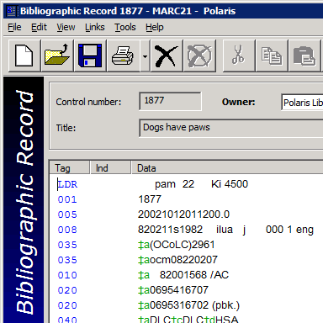
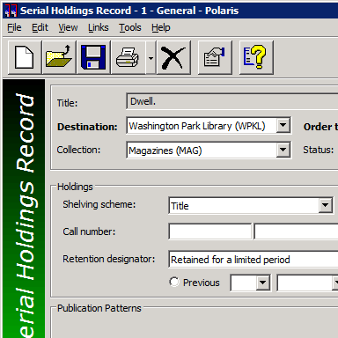
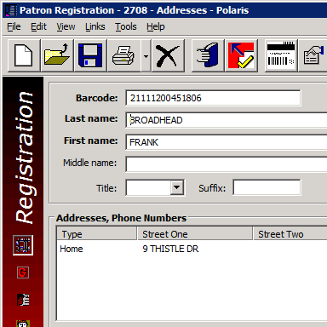
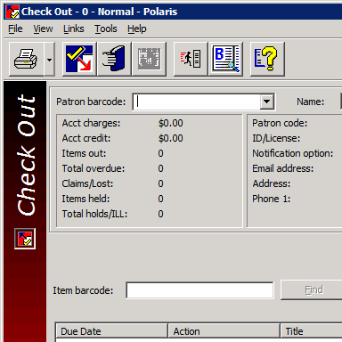
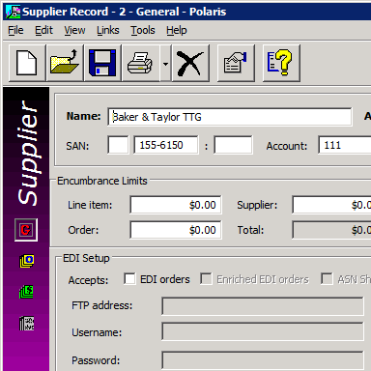
Workform layout
Cataloging
Serials
Patron Services
Acquisitions
Circulation
There are many different types of workforms in Polaris
Each workform is color coded by subsystem

Slide 34
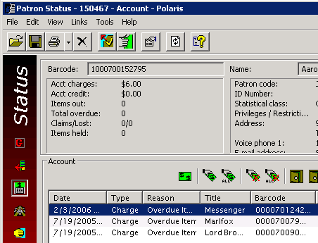
Workform layout
Menu bar
Toolbar
Line item toolbar
Views
Menu bar—access functions of the entire workform via drop-down menus
Toolbar—access functions of the entire workform via icons
Views—different pages of the workform
Line item toolbar—controls functions of the workform below itself

Slide 35
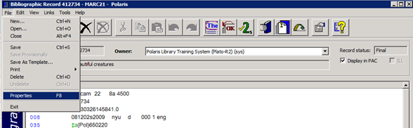
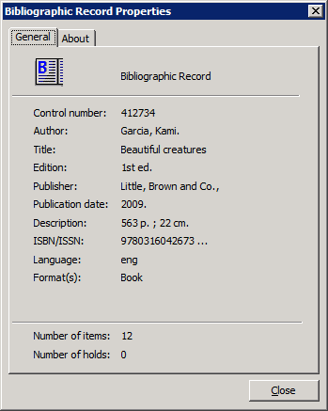
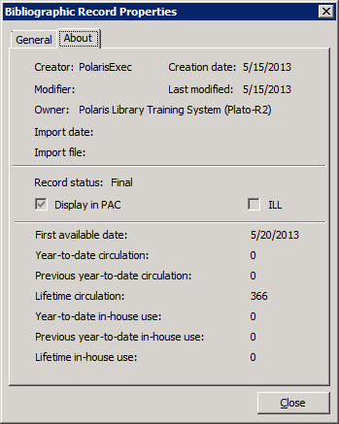
Property sheets
From most workforms you can go to File/Properties, use F8 or click the Properties icon to retrieve the corresponding property sheet
Property sheets contain useful information about records in the database

Slide 36
Record Sets
Purpose and types of record sets
Creating record sets

Slide 37
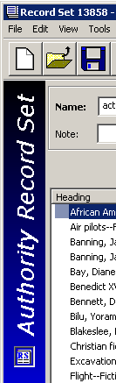
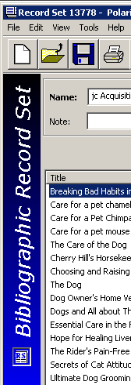
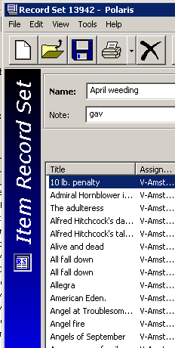
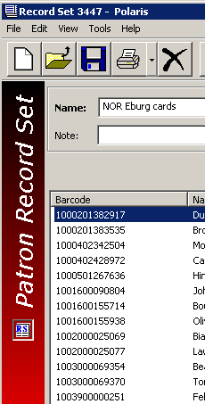
Purpose and types of record sets
Subsets/virtual groupings of Bibliographic, Item, Authority or Patron records
Records are grouped together for specific functions within Polaris—a listing of records or for bulk change purposes
Additional information regarding record sets will be communicated during Cataloging and Patron Services/Circulation training

Slide 38
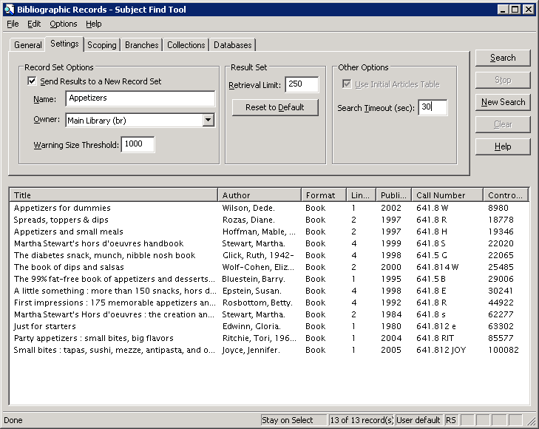
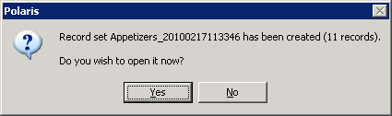
Creating Record Sets
There are many ways to create record sets
For example, using the settings tab in the Find Tool to create a record set directly from a results list

Slide 39
Creating record sets
Another option is available from the right-click functionality of the results list
Selected records may be put in a new or an existing record set
Multiple records may be selected for inclusion

